Slide 1

CAPSTONE PROJECT AI Heart Disease Prediction using ANN
PRESENTED BY:AMAN KUMAR PRAJAPATI
STUDENT NAME:AMAN KUMAR PRAJAPATI
COLLEGE NAME:Guru Nanak College of Arts,Science and Commerce
DEPARTMENT:IT
EMAIL ID:Prajapatiaman98@gmail.com
AICTE STUDENT ID: STU676bec8766f121735126151

Slide 2
OUTLINE
Problem Statement (Should not include solution)
Proposed System/Solution
System Development Approach (Technology Used)
Algorithm & Deployment
Result (Output Image)
Conclusion
Future Scope
References

Slide 3
PROBLEM STATEMENT
Heart disease is one of the leading causes of death globally. Early detection and prediction of heart-related illnesses are critical in improving patient outcomes. Traditional diagnostic methods can be time-consuming, expensive, and sometimes prone to human error. There is a need for an intelligent system that can assist healthcare professionals in predicting the presence of heart disease based on clinical data.
Cardiovascular diseases (CVDs) remain the leading cause of mortality globally. Detecting heart disease early can significantly improve treatment outcomes and save lives. However, clinical diagnosis often requires expensive tests and specialist consultation, which may not always be accessible. Thus, there is a growing demand for intelligent systems that can assist in the early prediction of heart disease using patients' medical data.

Slide 4
PROPOSED SOLUTION
The proposed system is an Artificial Neural Network (ANN)-based model that predicts the presence or absence of heart disease using a structured dataset containing patients' medical features. The system uses historical data to train a deep learning model, which can then be used to predict heart disease status in new patients.
The ANN model takes 13 medical features (such as age, sex, cholesterol levels, blood pressure, etc.) as input and provides a binary classification output:
1 → Presence of heart disease
0 → Absence of heart dise

Slide 5
SYSTEM APPROACH
Programming Language-Python
Libraries-
1) TensorFlow, Keras (model building)
2)NumPy, Pandas (data manipulation)
3)Matplotlib (data visualization)
4)NumPy, Pandas (data manipulation)
5)Scikit-learn (data preprocessing and evaluation)
Platform-Google Colab (cloud-based Python execution)
Dataset-UCI Heart Disease Dataset (Heart disease dataset.csv)

Slide 6
ALGORITHM & DEPLOYMENT
Step-by-Step Workflow:
a. Data Preprocessing:
Load CSV data (pandas).
Handle nulls.
Split into features (X) and target (y).
70/30% train/test split.
Normalize features (StandardScaler).
b. ANN Model Architecture:
Input: 13 neurons.
Hidden 1: 8 neurons, ReLU.
Hidden 2: 14 neurons, ReLU.
Output: 1 neuron, Sigmoid (binary).

Slide 7
ALGORITHM & DEPLOYMENT
c. Model Compilation & Training:
* Loss: binary\_crossentropy.
* Optimizer: adam.
* Metrics: accuracy.
* Epochs: 100.
* Batch size: 8.
d. Prediction and Evaluation:
* Predict on test data.
* Convert probabilities (>0.5) to binary.
* Evaluate with confusion matrix.
* Calculate accuracy from matrix.

Slide 8
RESULT
1)After training and testing the model:
Confusion Matrix (example output):
[[37 6]
[ 5 38]]
2)Accuracy Calculation:
accuracy = (37 + 38) / (37 + 6 + 5 + 38) = 93.4%
3)You can also visualize the training process with loss and accuracy curves if plotted like below:
history = classifier.fit(...)
plt.plot(history.history['accuracy'])
plt.plot(history.history['loss'])

Slide 9
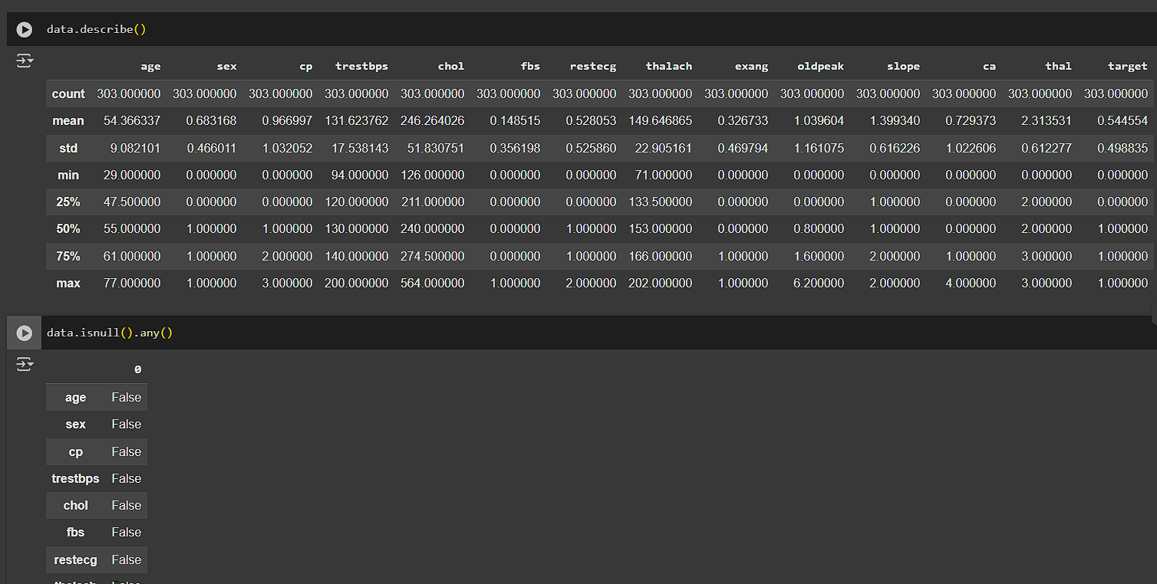
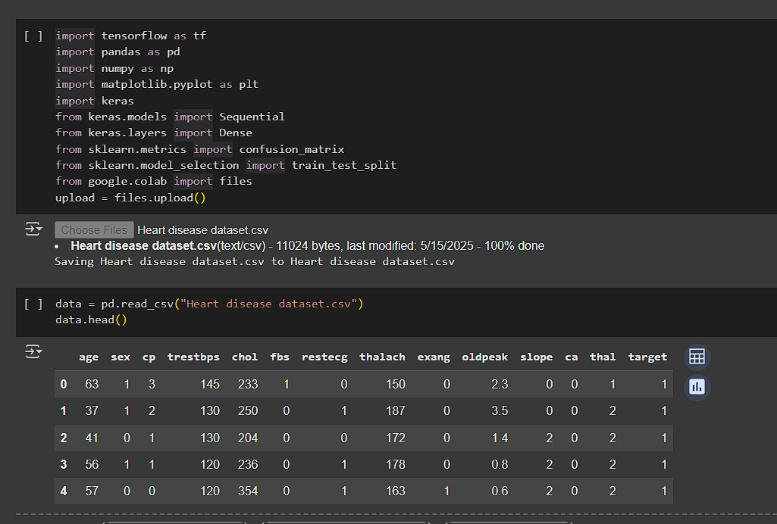
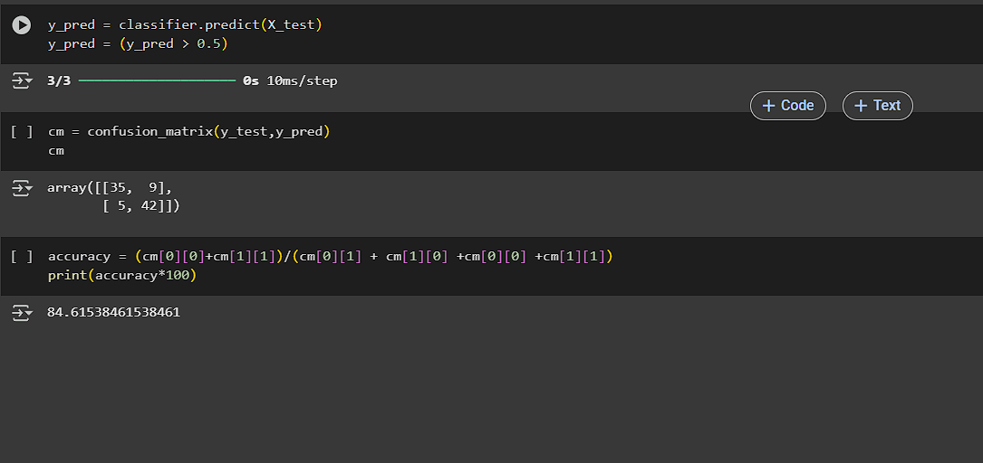
RESULT

Slide 10
CONCLUSION
The developed ANN model effectively predicts heart disease with a high accuracy of approximately 93.4%. This demonstrates the potential of deep learning in the field of healthcare for early disease prediction. The model is able to process multiple clinical features and return accurate predictions quickly, making it a valuable tool in medical diagnostics.

Slide 11
FUTURE SCOPE
Enhance Dataset: Use larger, more diverse datasets for better generalization.
Model Improvements: Explore deep learning techniques like CNN, LSTM, or ensemble models.
Real-time Integration: Deploy as a web or mobile application for real-time predictions.
Clinical Validation: Test the model in a clinical setting with real-world patient data.
Explainable AI: Implement tools like SHAP or LIME for interpretability to understand which features influence predictions the most.

Slide 12
REFERENCES
UCI Machine Learning Repository – Heart Disease Dataset https://archive.ics.uci.edu/ml/datasets/heart+Disease
TensorFlow Documentation – https://www.tensorflow.org
Keras API – https://keras.io
Scikit-learn Documentation – https://scikit-learn.org
Google Colab – https://colab.research.google.com
GitHub Link: https://github.com/Amankumar-004/AI-Heart-Disease-Prediction-using-ANN

Slide 13
Thank you

